Slide 1


Information Security
Lecture 1
Basic Security Concepts
Dr. Muazzam Ali Khan Khattak
Professor
Department of Computer Science
QAU, Islamabad
Email: muazzam.khattak@qau.edu.pk

Slide 2

















Prof. Dr. Muazzam A. Khan Khattak (SM NADRA/IEEE/PAS/AAAI) Listed in Top 2% Scientists of The World 2024, 25/Gold Medal PAS Director Farabi Centre AI & CS, S&T, ICESCO Chair. Chairperson UNESCO IFAP National Committee, Pakistan.
Research Areas
Artificial Intelligence (AI), Internet of Things (IoTs), Smart Cities,
Intelligent Networks, Information Security.
Research Profile:
International Grants: 350 M
OIC, ICESCO, UMKC, PAS, CHINA,
International Publications: 230
Impact Factor: 400+
Citations: 6614+
H-Index – 45
Product Developed: Safe Roam, Pollution Moniter
International Collaborations
China
Harbin Institute of Technology, Weihai, Northwest Polytech University, Uni of Electronic Sci & Technology, China.
USA
University of Missouri, Kansas State Uni, UNC Charlotte, TEXAM University.
UK & Germany
Uni of West London , Uni of Glasgow, Uni of Edinburgh, Napier, Uni of Ulm, Uni of Munich.
Kazakhstan & Saudi Arabia
Prince Sultan Uni, Imam Uni, Prince Muqrin Uni,
Türkiye & Malaysia
USAK Uni, University of Malaya, Sunway Uni,
Azerbaijan
Baku State University,
International Editorial and Organiser Roles
Co-Chair HoNET-ICT 2018,19,20,21,22, 23, 24,2025
C-CoDE-2019, 22. I-CoD-2 2022, 2023, 2025
Associate Editor IEEE Access,
Guest Editior in Journal: Computer Material and Continoua.
Reviewer in IEEE Transactions, Elsvier Journals, Springer & Wiley
Notes:
Updated on: 20/11/2016

Slide 3
Course Outline
Intro to Security, Security Services (Authentication, integrity, confidentiality),
Threats and goals of network security
Security Assessment and planning,
Firewalls and access control lists
Cryptography Algorithms like DES, 3DES, RSA, MD5, SHA etc.

Slide 4
Course Outline
Virtual private networks
Digital Signatures and Digital certificates, Certificate Authorities (PKI)
Security protocols like IPSEC, TLS/SSL
Authentication Protocols

Slide 5
Recommended Books
Cryptography and Network Security
Principles and Practices By William Stallings
Pearson Education – Prentice Hall
Cryptography and Network Security
By Behrouz A. Forouzen, McGraw-Hill
Security Engineering
A Guide to Building De Distributed Systems
By Ross Anderson, John Wily & Sons

Slide 6
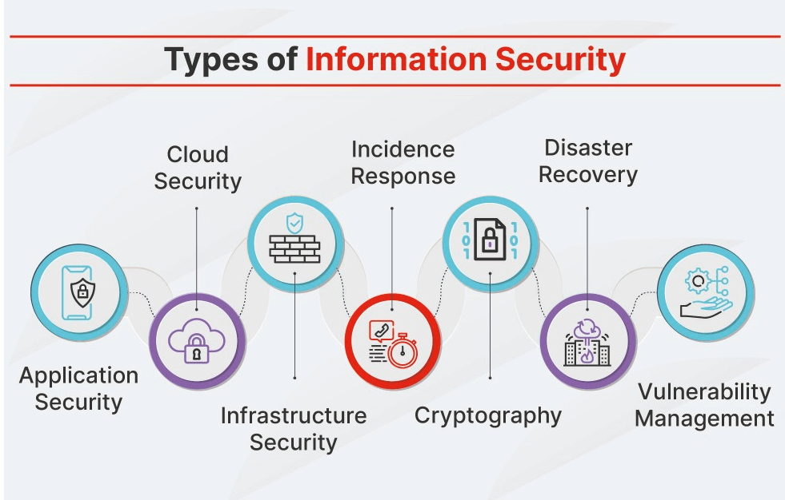
Background
Info Security requirements have changed in recent times
Traditionally provided by physical and administrative mechanisms
Computer use requires automated tools to protect files and other stored information
Use of networks and communications links requires measures to protect data during transmission
Notes:
The requirements of information security within an organization have undergone two major changes in the last several decades. Before the widespread use of data processing equipment,the security of information felt to be valuable to an organization was provided primarily by physical (eg. rugged filing cabinets with locks) and administrative mechanisms (eg. Personnel screening procedures during hiring process).
Growing computer use implies a need for automated tools for protecting files and other information stored on it. This is especially the case for a shared system, such as a time-sharing system, and even more so for systems that can be accessed over a public telephone network, data network, or the Internet.
The second major change that affected security is the introduction of distributed systems and the use of networks and communications facilities for carrying data between terminal user and computer and between computer and computer. Network security measures are needed to protect data during their transmission.

Slide 7
Focus of the Course
Measures to deter, prevent, detect, and correct security violations
Our focus is on the following security areas:
Computer Security
Network Security
Internet Security
Protect data during their transmission over a Collection of interconnected networks”
Notes:
Here are some key definitions, note boundaries between them are blurred.

Slide 8
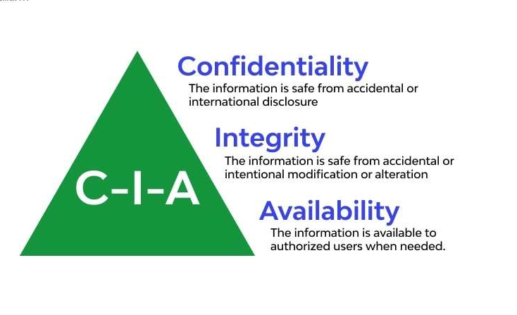
03 Important Concepts

Slide 9
Some Basic Terminology
Plaintext - original message
Ciphertext - coded message
Cipher - Algo for transforming plaintext to ciphertext
Key - info used in cipher known only to sender/receiver
Encipher (encrypt) - converting plaintext to ciphertext
Decipher (decrypt) - recovering ciphertext from P-text
Cryptography - study of encryption principles/methods
Cryptanalysis (Codebreaking) - study of principles/ methods of deciphering ciphertext without knowing key
Cryptology - field of both cryptography & cryptanalysis
Notes:
Briefly review some terminology used throughout the course.

Slide 10

https://moitt.gov.pk/SiteImage/Misc/files/National%20Cyber%20Security%20Policy%202021%20Final.pdf

Slide 11
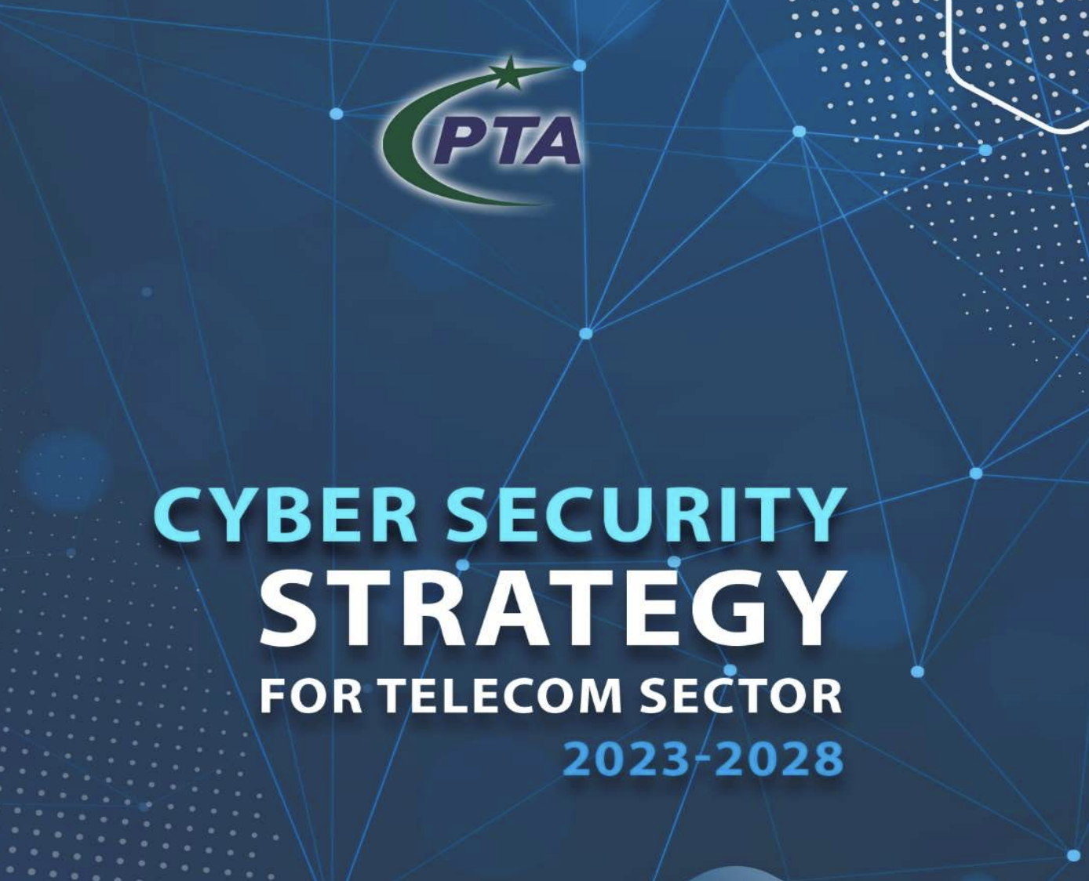
https://pta.gov.pk/assets/media/cyber_security_strategy_telecom_sector_2023_2028_11-12-2023.pdf

Slide 12
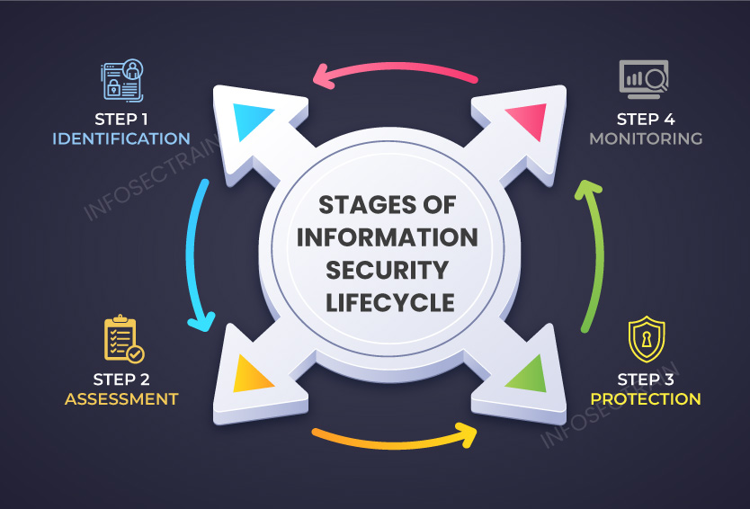
Life Cycle of Info Security
Notes:
Here are some key definitions, note boundaries between them are blurred.

Slide 13
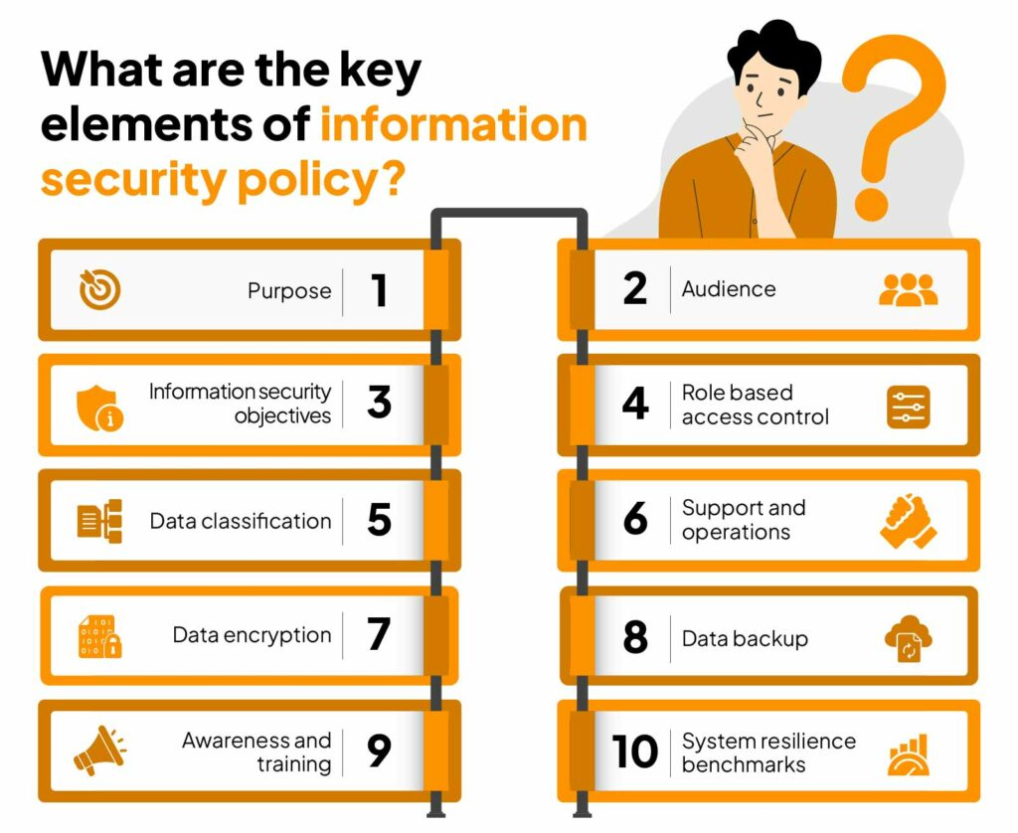
Notes:
Here are some key definitions, note boundaries between them are blurred.

Slide 14
Top Cyber Attacks in 2024

Slide 15
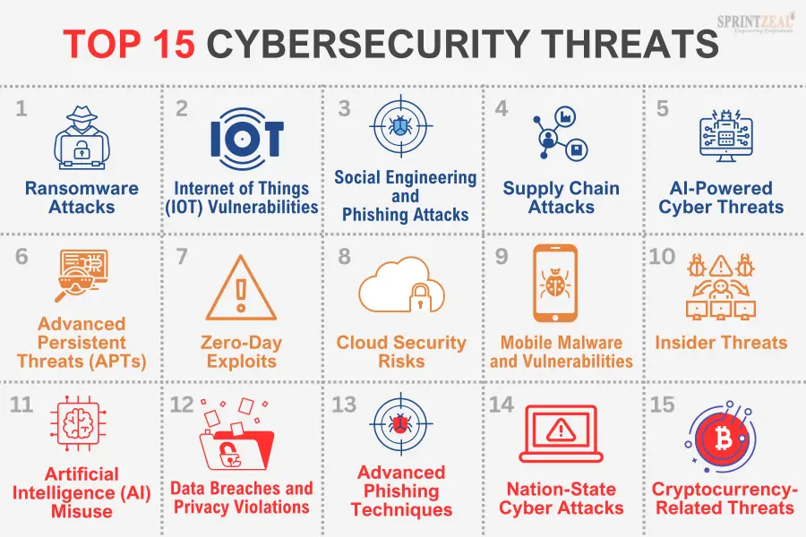
Notes:
Discuss observed security trends (Stallings section 1.1 & Figure 1.2 above), noting growth in sophistication of attacks contrasting with decrease in skill & knowledge needed to mount an attack.

Slide 16
Security Aspects
ITU-Standardized “Security Architecture for OSI”
It explains systematic way of defining and providing security requirements
Information security have 3 aspects
Security attacks
Security mechanisms
Security services
Notes:
To assess effectively the security needs of an organization and to evaluate and choose various security products and policies, the manager responsible for security needs some systematic way of defining the requirements for security and characterizing the approaches to satisfying those requirements. This is difficult enough in a centralized data processing environment; with the use of local and wide area networks,the problems are compounded. ITU-T Recommendation X.800, Security Architecture for OSI, defines such a systematic approach. The OSI security architecture is useful to managers as a way of organizing the task of providing security.

Slide 17
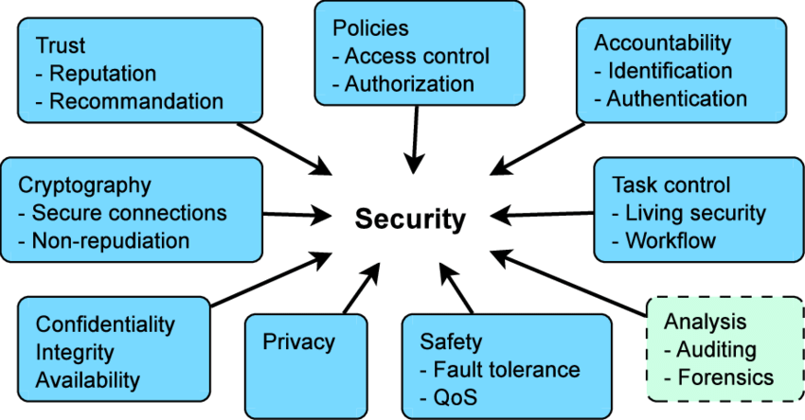
Major Security Aspects in a Collaboration System

Slide 18
Threats and Attacks
Threat
A threat is a possibility by which desired system properties may be violated
Attack
Any action that compromises the information security
An intelligent act that is a deliberate attempt to evade security services and violate the security policy.
Notes:
Expand on definition and use of “security attack”, as detailed above.
See Stallings Table 1.1 for definitions of threat and attack.

Slide 19
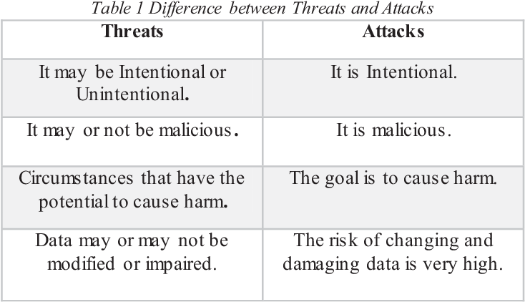
Difference Btw Threats & Attacks

Slide 20
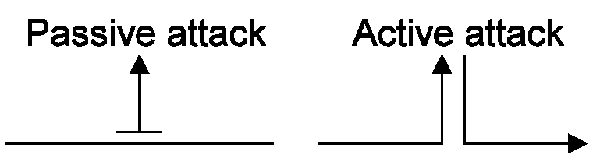
Types of Security Attacks
In general threat & attack have the same meaning
Today we have wide range of attacks possibilities due to open-based architecture
Generic types of attacks
passive
active
Notes:
Expand on definition and use of “security attack”, as detailed above.
See Stallings Table 1.1 for definitions of threat and attack.

Slide 21
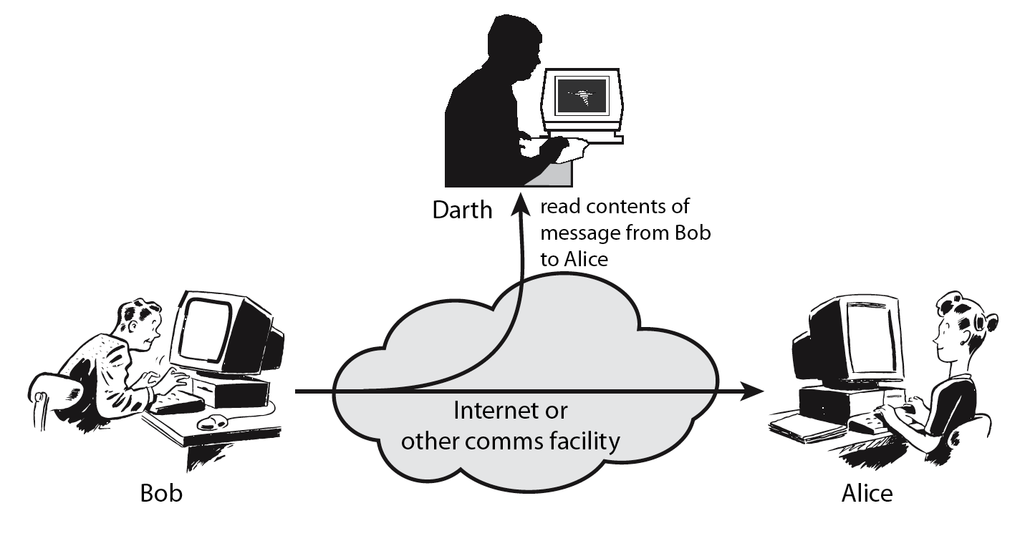
Passive Attacks
Attempt to learn or make use of information from the system but does not affect system resources
obtain message contents
traffic analysis or monitor traffic flows
Notes:
Have “passive attacks” which attempt to learn or make use of information from the system but does not affect system resources.
By eavesdropping on, or monitoring of, transmissions to:
+ obtain message contents (as shown above in Stallings Figure 1.3a), or
+ monitor traffic flows
Are difficult to detect because they do not involve any alteration of the data.

Slide 22
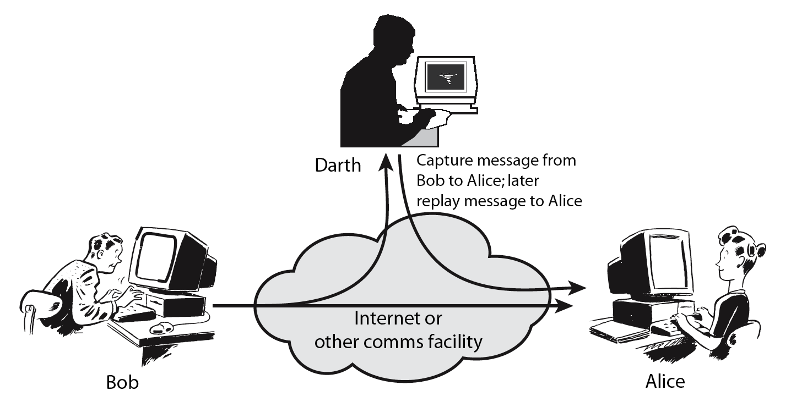
Active Attacks
Attempt to alter system resources or affect their operation
masquerade of one entity as some other
replay previous messages
modify messages in transit
denial of service
Notes:
Also have “active attacks” which attempt to alter system resources or affect their operation.
By modification of data stream to:
+ masquerade of one entity as some other
+ replay previous messages (as shown above in Stallings Figure 1.4b)
+ modify messages in transit
+ denial of service
Active attacks present the opposite characteristics of passive attacks. Whereas passive attacks are difficult to detect, measures are available to prevent their success. On the other hand, it is quite difficult to prevent active attacks absolutely, because of the wide variety of potential physical,software,and network vulnerabilities. Instead, the goal is to detect active attacks and to recover from any disruption or delays caused by them.

Slide 23
Masquerade
An entity pretends to be another
IP spoofing
How to protect?
Entity Authentication

Slide 24
Replay
First capture of data and then retransmission to produce an unauthorized effect
How to protect?
Time stamps
Sequence Numbers

Slide 25
Modification of Messages
Some portion of a legitimate message is altered or messages are delayed or reordered to produce an unauthorized effect
How to protect?
Message Authentication Codes
Chaining

Slide 26
Denial of Service - DOS
Prevents the normal use of communication systems
Serious threat to web servers
On the Internet, hackers can crash the TCP/IP by exploiting known vulnerabilities
Constantly updates the security patches

Slide 27
Security Threats
Which threats are active and passive ?

Slide 28
Threats Effect on Information Systems
Interruption (Denial of Service)
Interception (Theft)
HARDWARE
Interruption (Deletion)
Interception (Theft)
SOFTWARE
Modification (Malicious Code)
Interruption (Loss)
Interception (Eavesdropping)
DATA
Modification
Fabrication

Slide 29
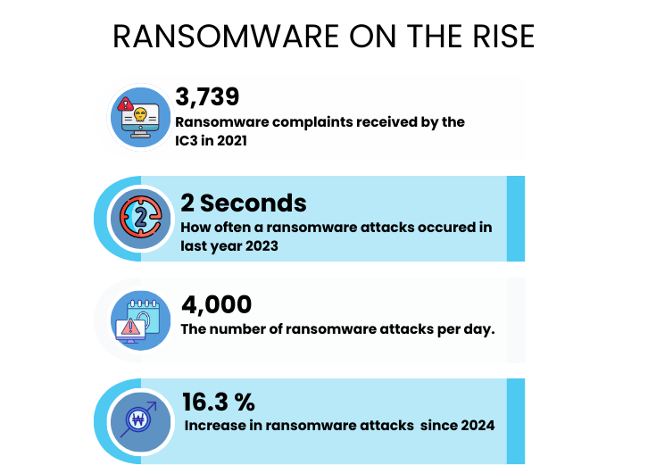

Slide 30
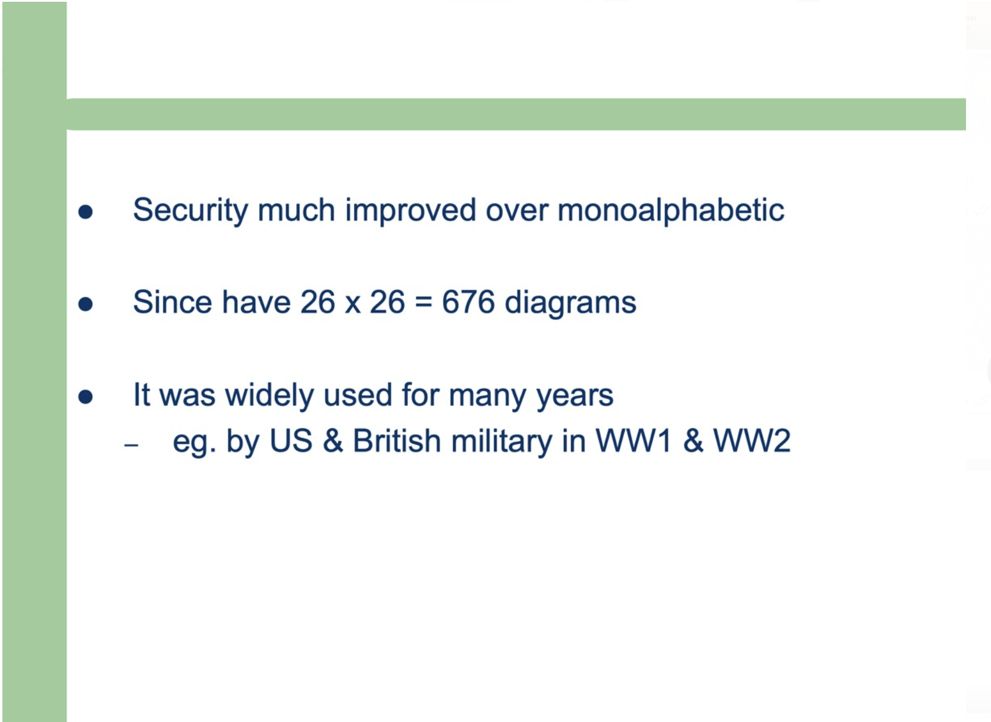

Slide 31
Security Services and Mechanisms
Security Mechanism
A mechanism that is designed to detect, prevent, or recover a security attack
A possible means to provide (implement) a security service
Security Service
A measure which can be put in place to address security threat
A service that enhances the security of data processing systems and information transfers
A security service makes use of one or more security mechanisms
Security functions normally associated with physical documents are:
signatures & dates
be notarized or witnessed
be recorded or licensed

Slide 32
Security Services
Authentication
assurance that the communicating entity is the one claimed
Access Control
prevention of the unauthorized use of a resource
Data Confidentiality
protection of data from unauthorized disclosure
Data Integrity
assurance that data received is as sent by an authorized entity
Non-Repudiation
protection against denial by one of the parties in a communication
Reliability
Data is received to whom it was sent
Availability
denial of service attacks
virus that deletes files
Notes:
This list includes the various "classic" security services which are traditionally discussed.
Note there is a degree of ambiguity as to the meaning of these terms, and overlap in their use.
See Stallings Table 1.2 for details of the 5 Security Service categories and the 14 specific services given in X.800.

Slide 33
Security Requirements
Confidentiality
Integrity
Availability

Slide 34
Types of Security Mechanisms
Security mechanisms are the specific means of implementing one or more security services
No single mechanism that will support all security services
Most of the security mechanisms based on cryptographic techniques
Two types of security mechanisms
Specific security mechanisms (protocol specific layer)
encipherment,
digital signatures,
Notes:
Now introduce “Security Mechanism” which are the specific means of implementing one or more security services.
Note these mechanisms span a wide range of technical components, but one aspect seen in many is the use of cryptographic techniques.

Slide 35
Types of Security Mechanisms
Access controls,
Data integrity,
Authentication exchange,
Traffic padding,
Routing control,
Pervasive security mechanisms
Trusted functionality,
Security labels,
Event detection,
Security audit trails,
Security recovery
Notes:
Some examples of mechanisms from X.800. Note that the “specific security mechanisms” are protocol layer specific, whilst the “pervasive security mechanisms” are not. We will meet some of these mechanisms in much greater detail later.
See Stallings Table 1.3 for details of these mechanisms in X.800, and Table 1.4 for the relationship between services and mechanisms.

Slide 36
Security Mechanisms Deployment

Slide 37
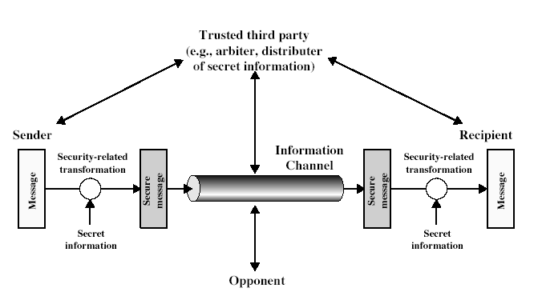
Security Model
Design a suitable algorithm for the security transformation
Generate the secret information (keys) used by the algorithm
Develop methods to distribute and share the secret information
Specify a protocol enabling the principals to use the transformation and secret information for a security service
Notes:
In considering the place of encryption, its useful to use the following two models from Stallings section 1.6.
The first, illustrated in Figure 1.5, models information flowing over an insecure communications channel, in the presence of possible opponents. Hence an appropriate security transform (encryption algorithm) can be used, with suitable keys, possibly negotiated using the presence of a trusted third party.

Slide 38
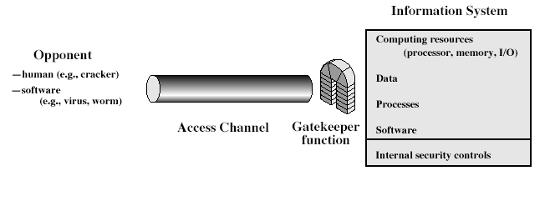
Network Access Security Model
Select appropriate gatekeeper functions to identify users
Implement security controls to ensure only authorised users access designated information or resources
Trusted computer systems may be useful to help implement this model
Notes:
The second, illustrated in Figure 1.6, model is concerned with controlled access to information or resources on a computer system, in the presence of possible opponents. Here appropriate controls are needed on the access and within the system, to provide suitable security. Some cryptographic techniques are useful here also.

